Slide 1
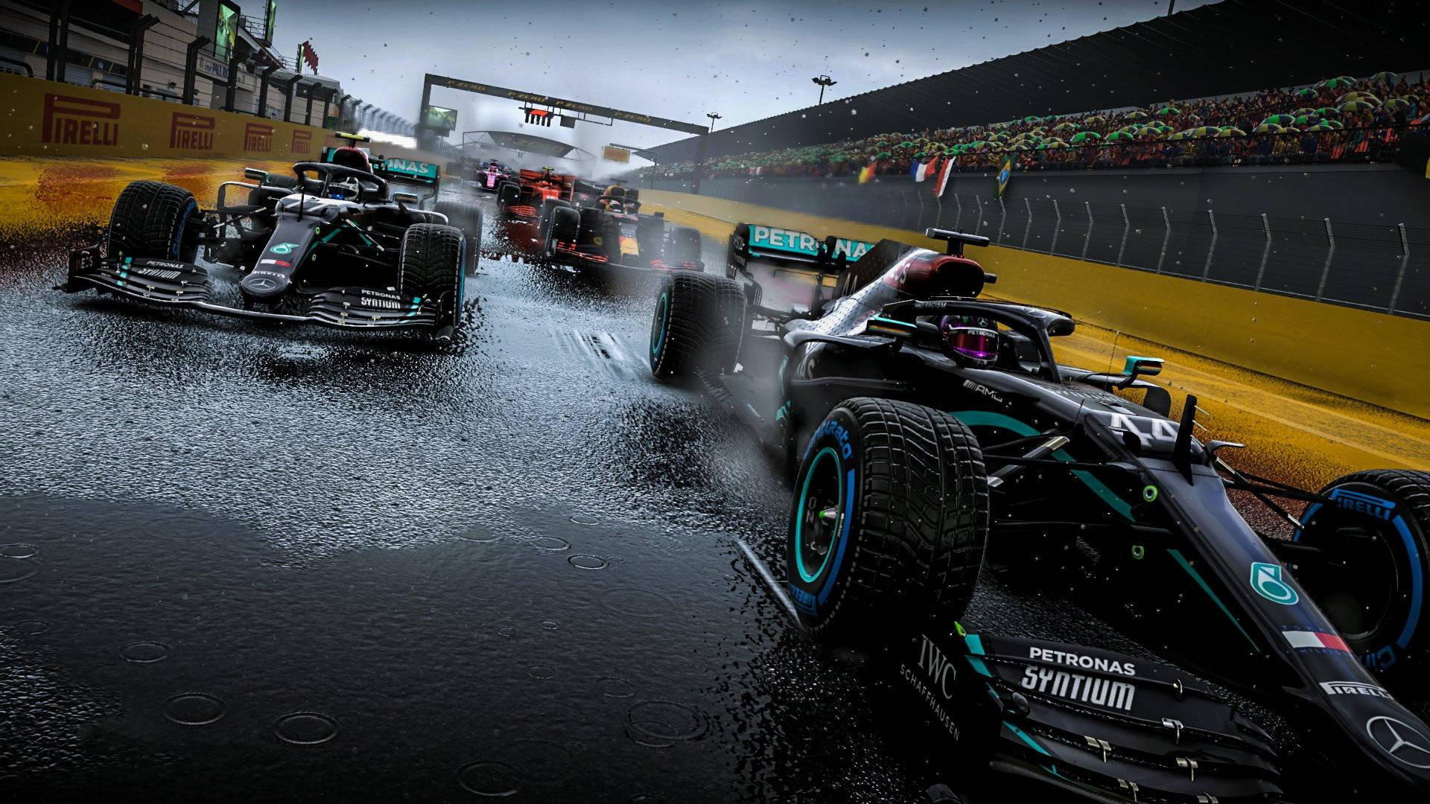
F1 Data Science Project
By Shrey, Nirbhaya, Rishi, and Akshay

Slide 2

Overview of Formula 1
What is Formula 1?
Formula 1 is the highest form of global single-seater motorsport
Teams compete in the FIA Formula One World Championship, competing in the Drivers Championship and Constructors Championship
Season:
Roughly 20 Grand Prix races per season
Races occur across 5 continents during the course of the season
Track Types vary
Classic circuits
Street circuits
Hybrid layouts
Scoring and Prize Money
Drivers and teams earn points each race based on finishing position
Total prize pool ≈ $900M–$1.1B annually
Finishing higher in the standings can mean $10M–$20M+ swings per position
Notes:
Formula 1 overview

Slide 3

The Problem at Hand
Race engineers must decide upon various items with incomplete information to put their teams in the best position to succeed:
When should the driver pit?
How will track and weather evolution affect pace?
How aggressive to be in overtaking and when to defend positions?
Model Type | Lap Time Prediction Model | Tire Strategy Model
Functionality | Forecasts expected lap times based on tires, track temps, fuel load, and driving inputs | Uses historical data to identify which tire compounds and stint lengths lead to better outcomes
Benefits | Reduces uncertainty for engineers in optimal race planning | Enables teams to generalize strategy rules and lessen “gut-feel” decisions
Notes:
Quick Overview of the problem being solved

Slide 4
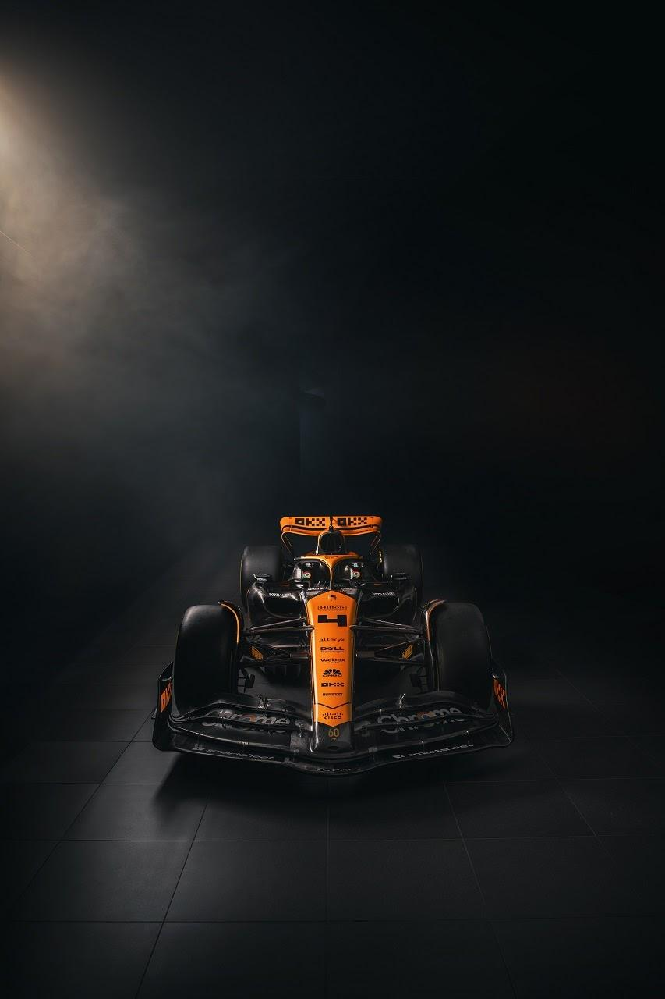
Data-Driven Strategies have high importance and impacts
Our models will improve in-race decision making
Optimal Strategy = Optimal Race Outcomes
Optimal tire and pit-stop strategies can gain or lose 20–30 seconds over a race
Millions of Dollars at Stake
Finishing position impacts prize money, sponsorship value, and team reputation
.
Competitive Advantage
Teams with superior predictive capability make faster, more accurate decisions
Small improvements each lap lead to impactful results.
Undercut/overcut attempts succeed only if you accurately anticipate next-lap pace.
Data-Driven Strategy
Replaces intuition-only calls with statistically grounded predictions
Better Tire & Pit-Stop Planning
Knowing whether a driver can extend a stint without losing too much time.
Scenario Simulation
Predicting whether next lap is fast enough to gain track position.
More Confident Real-Time Decisions
Engineers can evaluate “If we pit now vs. later” with predicted lap deltas.
Reduced Risk
Avoid unexpected tire drop-off or time-loss from poor compound selection.
Notes:
Why this problem matters

Slide 5
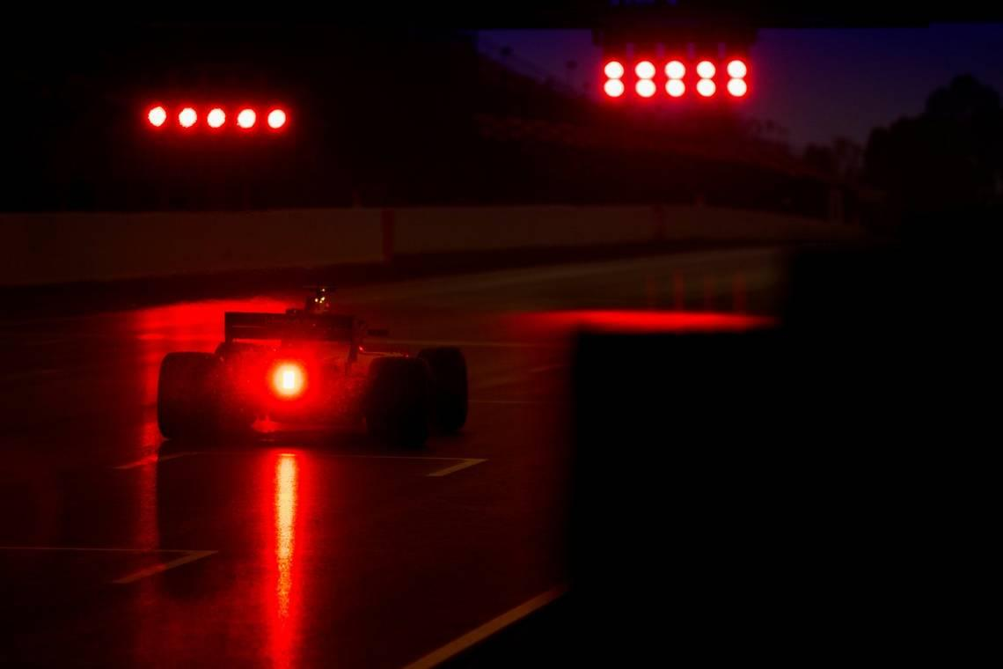
Who we are
We are four data scientists that determine race strategy for a prominent F1 team
We are specifically responsible for:
Building predictive models to estimate lap performance
Supporting race engineers in making pit-stop and tire-strategy calls
Turning raw telemetry & race data into actionable insights
Our goal:
Use machine learning to transform complex race variables into easily digestible forecasts for team engineers and drivers such that in-race strategic decisions are made with high levels of confidence
Notes:
Who we are

Slide 6
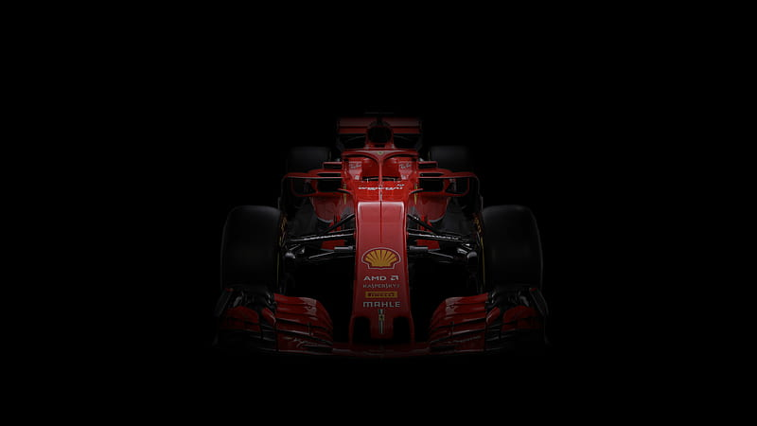
Key Decisions and Required Predictions
The key decisions that we are looking to support are the following:
Pit stop Timing:Identifying when pace is falling
When to schedule pit-stops to minimize total race time?
How can drivers account for environmental conditions such as track temperature, air temperature, humidity, and wind speed during a race to maximize their performance?
These decisions will ultimately revolve around the outcome that we are trying to predict:
Expected lap time under varying tire compounds
Lap time variance
Impact of track and weather variables
Notes:
Tire compound selection: How can we choose the correct blend of materials that can product an ideal amount of performance, traction, and resistance on the ground for a driver during the race?

Slide 7
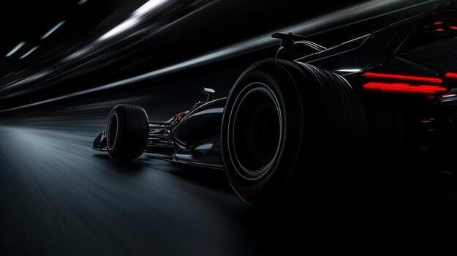
How Predictions Influence Decisions
Predict how lap time deteriorates throughout the race to help optimize when drivers should make a trip to the pit-stop.
If predicted lap times start slowing more than the pit-stop time we would lose the race, so we should pit.
If predicted pace suggests we will hit traffic later, we pit early to avoid getting stuck.
How hard should drivers push on each lap?
If predicted lap-time variation increases, then the driver should stabilize pace.
If predicted top-speed indicates a better straight-line pace, we can be aggressive with overtaking attempts.
How can we account for weather?
If the weather conditions change during race, how will it affect the lap time.
Faster predicted lap -> attempt undercut
Slower predicted lap -> defend/change plan

Slide 8
Overview of Data
Data Source: Collected lap-level data for 2022 and 2023 using the FastF1 API.
47,033 total laps across 2 seasons (2022: 23,050 laps, 2023: 23,983 laps)
44 Grand Prix races (22 per season)
31 Features including:
Tire Data: compound, tire life, stint number
Race Context: lap number, position, pit stops, track status
Weather: air temp, track temp, humidity, wind speed, pressure
Performance: lap times, sector times, speed
Notes:
Formula 1 overview

Slide 9
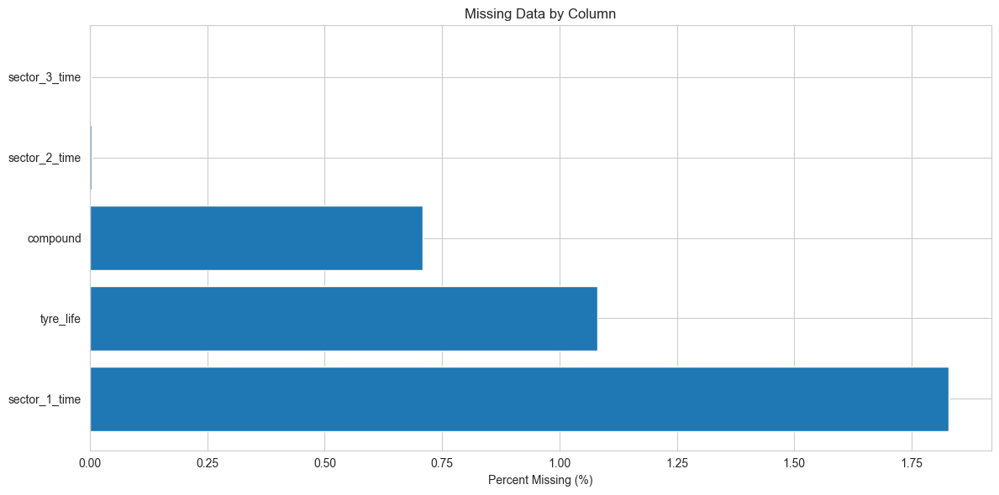
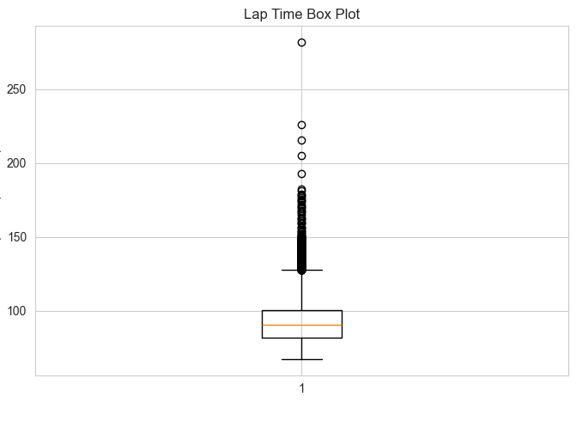
EDA
Missing Data Analysis
sector_1_times: ~ 1.75%
tyre_life: ~ 1%
compound ~ 0.7%
Handling Missing Data:
Numeric Features: Filled with median value
Categorical features: Filled with mode values
Outliers Analysis
Boxplot shows some extreme values (>150)
Kept outliers:
Pit laps
Safety car periods
Racing car incidents
Notes:
Who we are

Slide 10
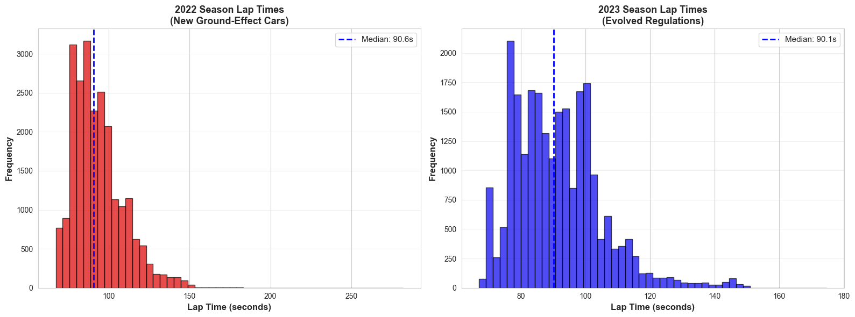
Key Insights
Findings:
Regulatory changes from 2022 to 2023
2022 median: 90.6s | 2023 median: 90.10
Difference: Only 0.55s
Regulation change had Minimal Effect
Impact
Validated combining 2022 and 2023 data
Notes:
Why this problem matters

Slide 11
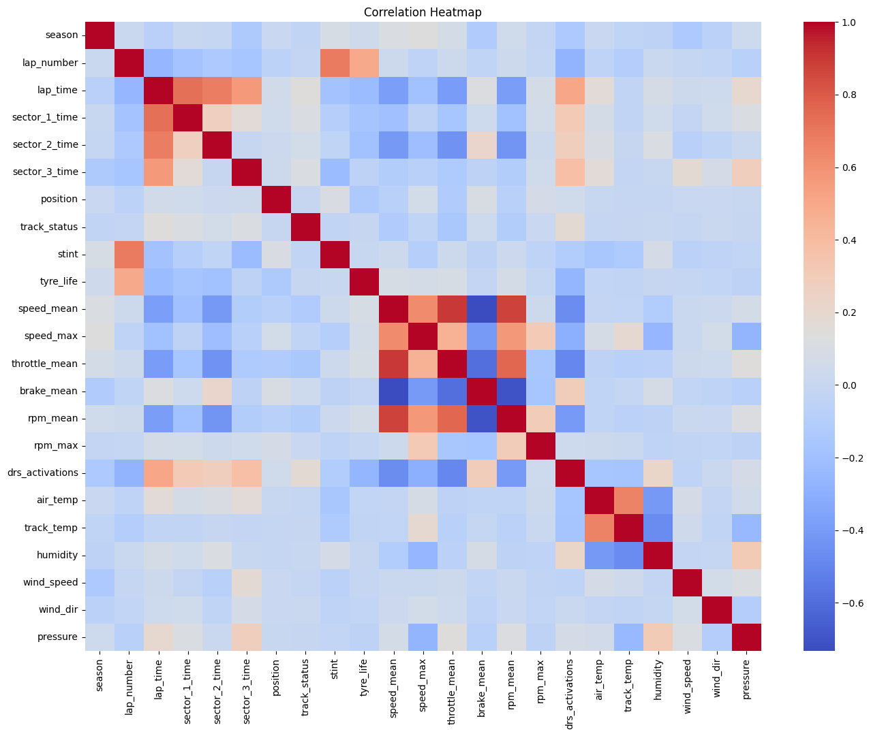
Feature Selection & Engineering
Included (28 Features):
Tyre Data: tyre_life, compound, stint, fresh_tyre
Race Context: lap_number, position, track_status, is_pit_lap
Weather: air_temp, track_temp, humidity, wind_speed, pressure,
wind_dir
Categorical: driver, team, compound, track_status
Feature Engineering: Rolling Window Approach
Lag features: prev_lap_time, prev2_lap_time, prev3_lap_time
Mimics live racing
Rolling averages: rolling_mean_3, rolling_mean_5, rolling_std_3
Captures recent performance trends
Weather changes: air_temp_changes, track_temp_changes
Evolving track conditions
Notes:
Formula 1 overview

Slide 12
Modeling Overview
Project Goal: Predict F1 lap times in real-time during a race to inform pit stop strategy and race tactics.
Dataset: Multi-Year 2022-2023 Seasons, totaling ~47,000 laps across 44 Grand Prix races.
Models Tried:
Random Forest Regressor
Gradient Boosting Regressor
XGBoost Regressor
Notes:
Who we are

Slide 13
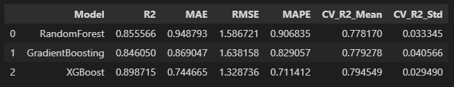
Performance
Notes:
Quick Overview of the problem being solved

Slide 14
Metrics
Most Relevant Metric: Mean Absolute Error (MAE), since it provides the average magnitude of error in seconds. This is a direct, intuitive, and critical piece of information for race strategists.
XGBoost has an MAE of 0.74 seconds means that, on average, our prediction for the next lap will be off by less than one second.
Another Key metric is R2 score. R2 score of 0.899 means the model explains almost 90% of the variance in lap times. This shows the model is robustly capturing the underlying physics and trends.
Notes:
Formula 1 overview

Slide 15
Data for Testing
Train Set: All Grand Prix of season 2022, 2023 with session type R (except the test set).
Test Set: The entire 2023 United States Grand Prix (US GP). Approximately 934 rows.
This prevents data leakage as well as instances where future data is used to predict past ones.
Notes:
Why this problem matters

Slide 16
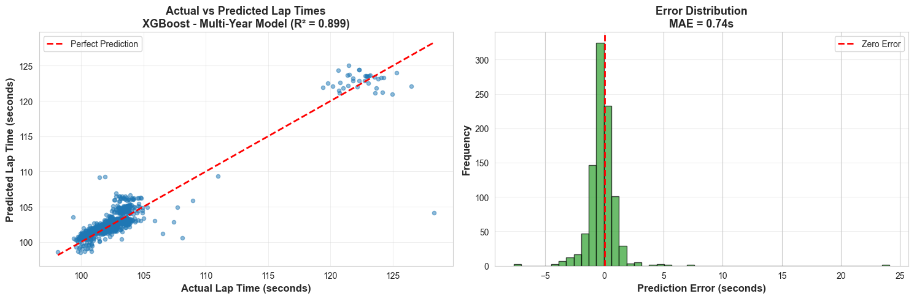
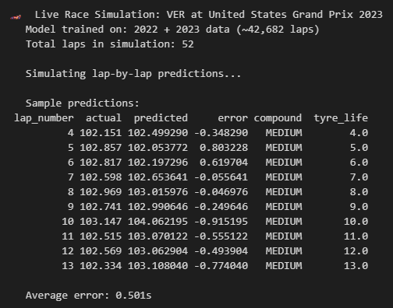
Notes:
Quick Overview of the problem being solved

Slide 17
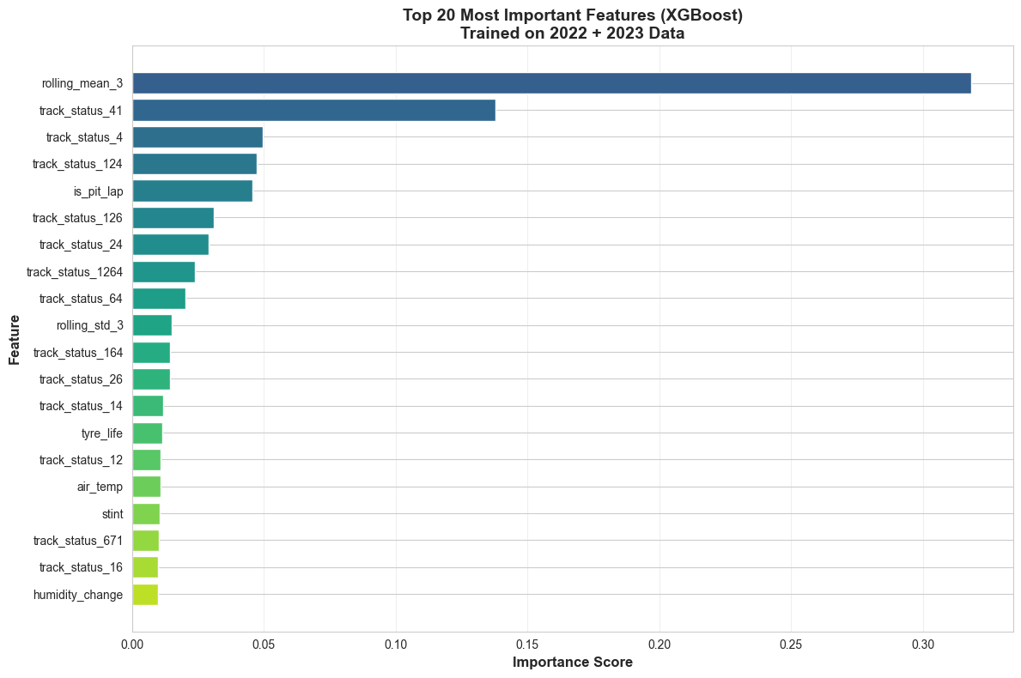
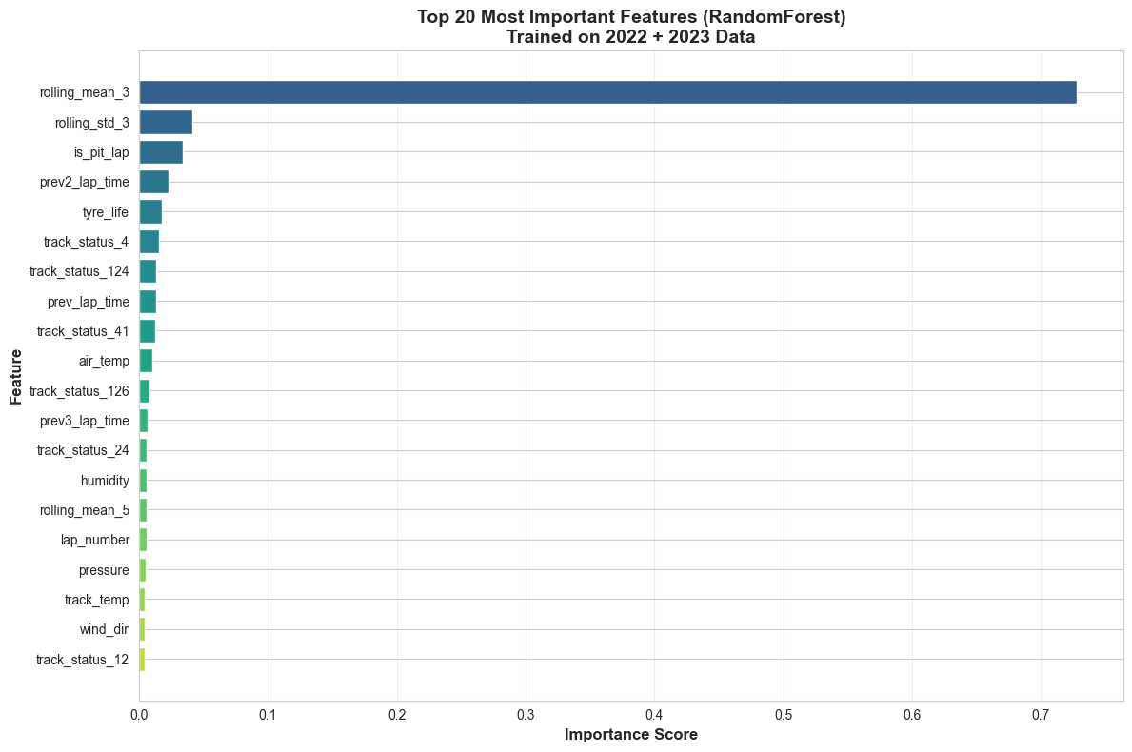
Notes:
Formula 1 overview

Slide 18
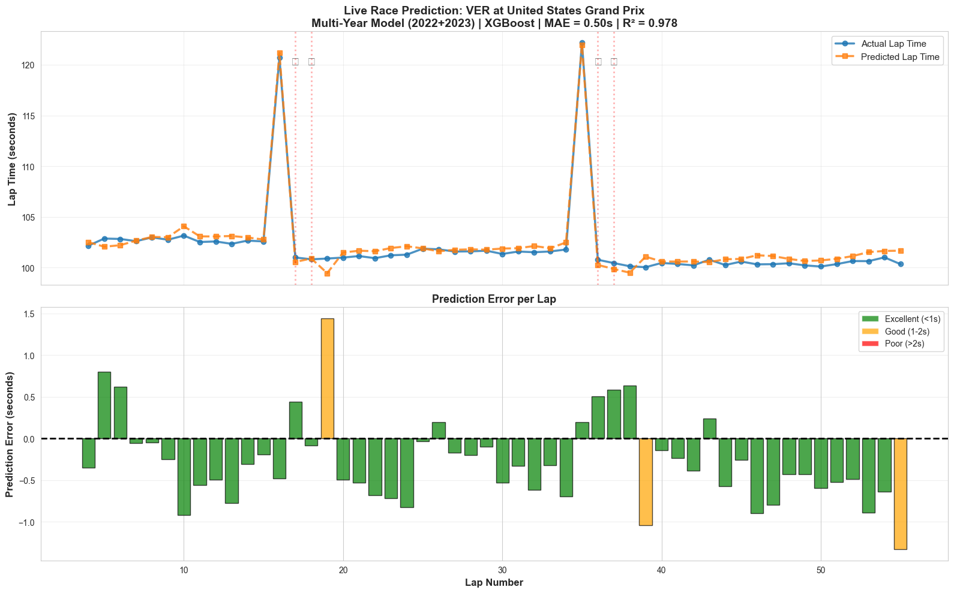
Notes:
Why this problem matters

Slide 19
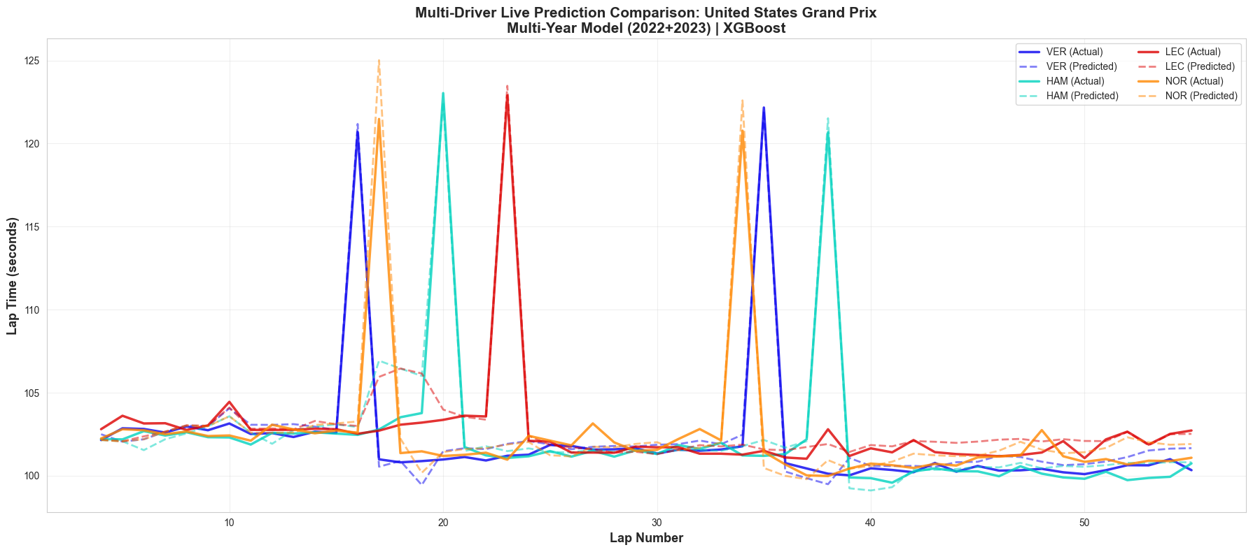
Notes:
Why this problem matters

Slide 20
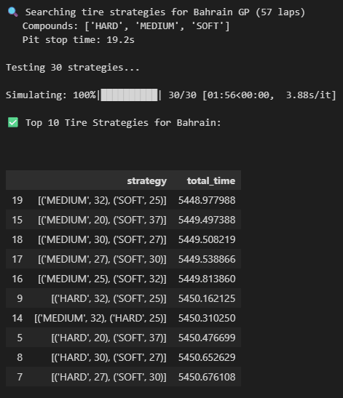
Tyre Strategy
We also made an attempt to make tyre strategy recommendation model. Wherein based on lap time prediction, we recommend driver when to take a pit stop, which tyre compounds to use based on least total race time.
But this model isn’t perfect since we do not have important
features such as fuel usage, car aerodynamics, tyre
Degradation, driver strategy/management, real time
Contextual data etc.
For a workaround, we tried to simulate fuel consumption
and used it as a feature too.
Notes:
Who we are

Slide 21
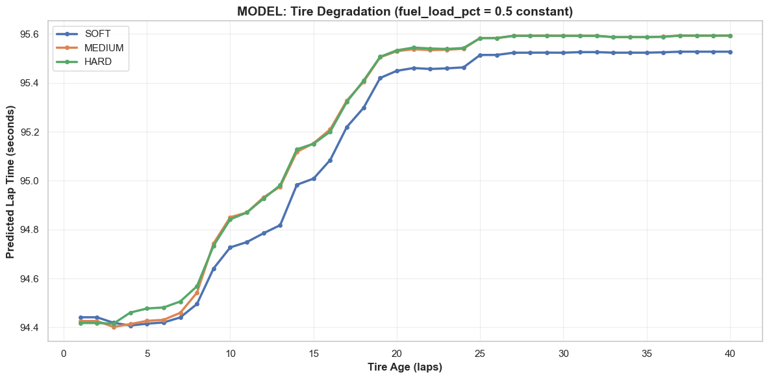
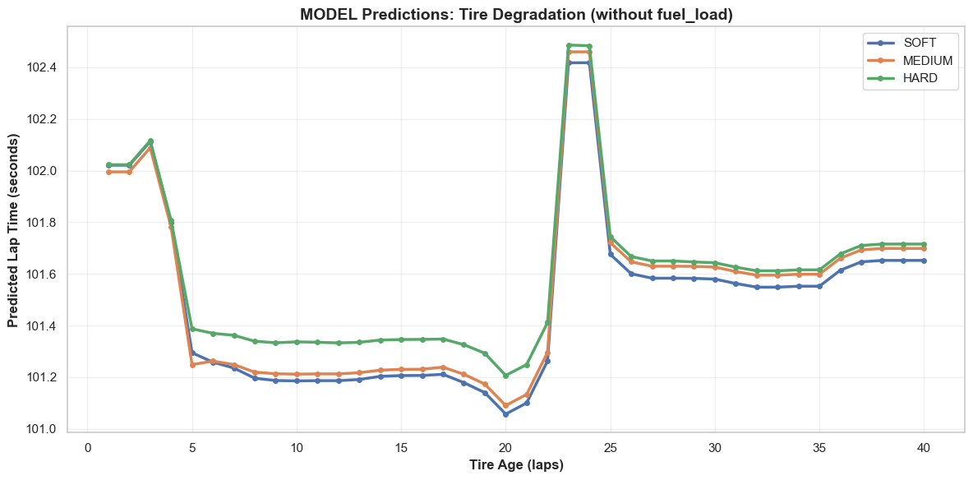
Notes:
Formula 1 overview

Slide 22
Model Deployment
These models are perfectly suitable for integration into Team’s Race Strategy Software since we can use it before the Grand Prix starts as well as during the race too.
Can be used to make real time pit stop strategy when a new set of tyre will help in reducing lap time, driver feedback, set live pace target for driver, ensuring they are pushing without unnecessarily degrading tires too quickly.
The data we currently have is available to public so these will be available “In the Wild”. But if we have access to more specific data such as tyre pressure, fuel usage, car weight, car specific dynamics, etc.
Notes:
Who we are

Slide 23
Bias
Ensuring model built on historical data as sport evolves as in regulation changes, car aerodynamics evolution, tire compound changes, degradation profiles.
Model may struggle with conditions it has never seen (e.g. severe localized weather, red flag restart dynamics, etc).
Model may under-predict the lap times of drivers known for exceptional tire preservation and over-predict the times of drivers known for aggressive, tire-abusing pace.
If a new circuit with a highly unusual combination of characteristics (e.g., extremely low speed corners combined with high altitude) is introduced, the model may struggle to generalize the feature relationship.
Notes:
Quick Overview of the problem being solved

Slide 24
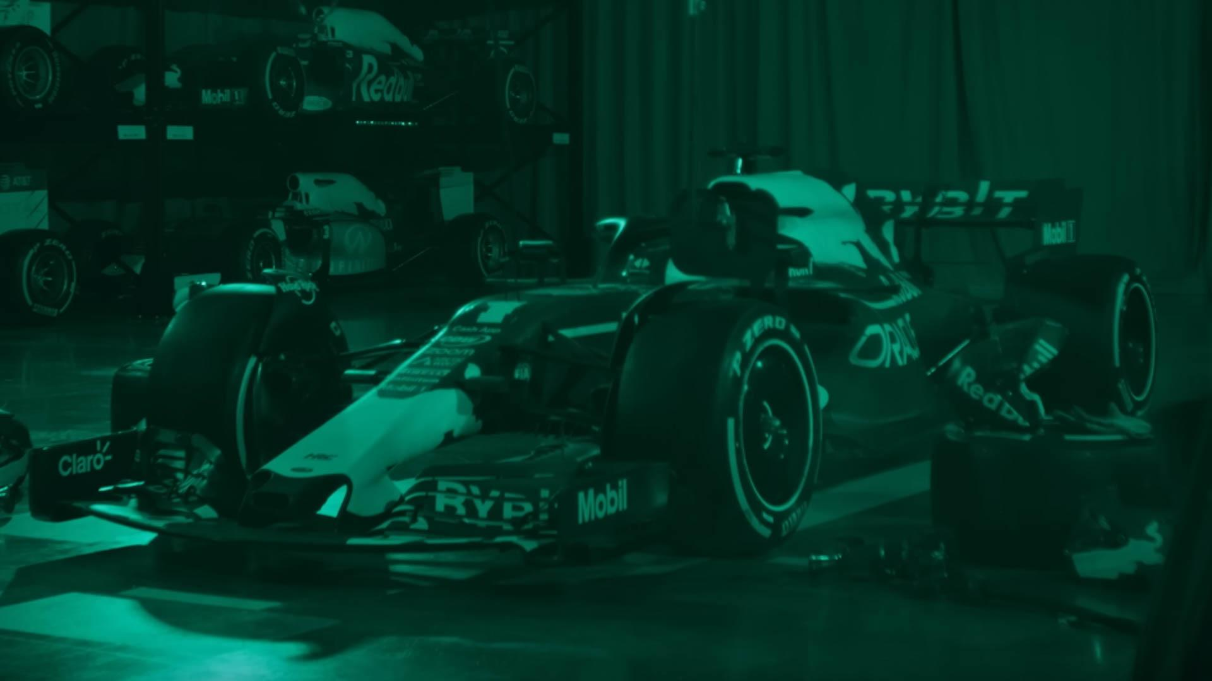
High-Impact, Realistic Data to add into Model
Harder To Access Data that will add value to Model
Fuel load and burn rate
Sector & mini-sector timing data
GPS traces for car positioning
Driver inputs (throttle, brake, steering)
Race context (gaps, traffic, flags, DRS)
ERS deployment & recovery usage
Brake temperature & Power Unit health indicators
Clean-air vs. dirty-air aero impact
Normalizing for driver style and habits
Tire warm-up models
Competitor stint-pace projections
Car setup parameters (wing levels, suspension settings)
Notes:
Why This Data Matters Collecting must-have data ensures the model captures the core physical and strategic factors that directly influence lap times—tire behavior, fuel load, track conditions, and driver inputs. These variables provide the foundation for accurate pace prediction and allow the model to reflect the real forces teams manage on race day.
Nice-to-have data adds another layer of nuance by incorporating mechanical health, driver style, and competitor modeling, which teams use to refine strategic decisions in practice. While harder to access, these features elevate the model from “accurate” to “race-strategy ready,” enabling scenario planning that mirrors what top F1 teams do in their simulation tools.

Slide 25
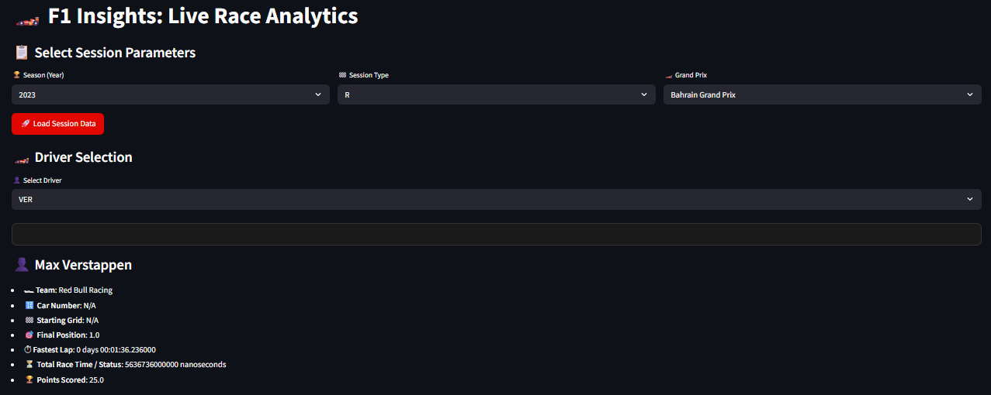
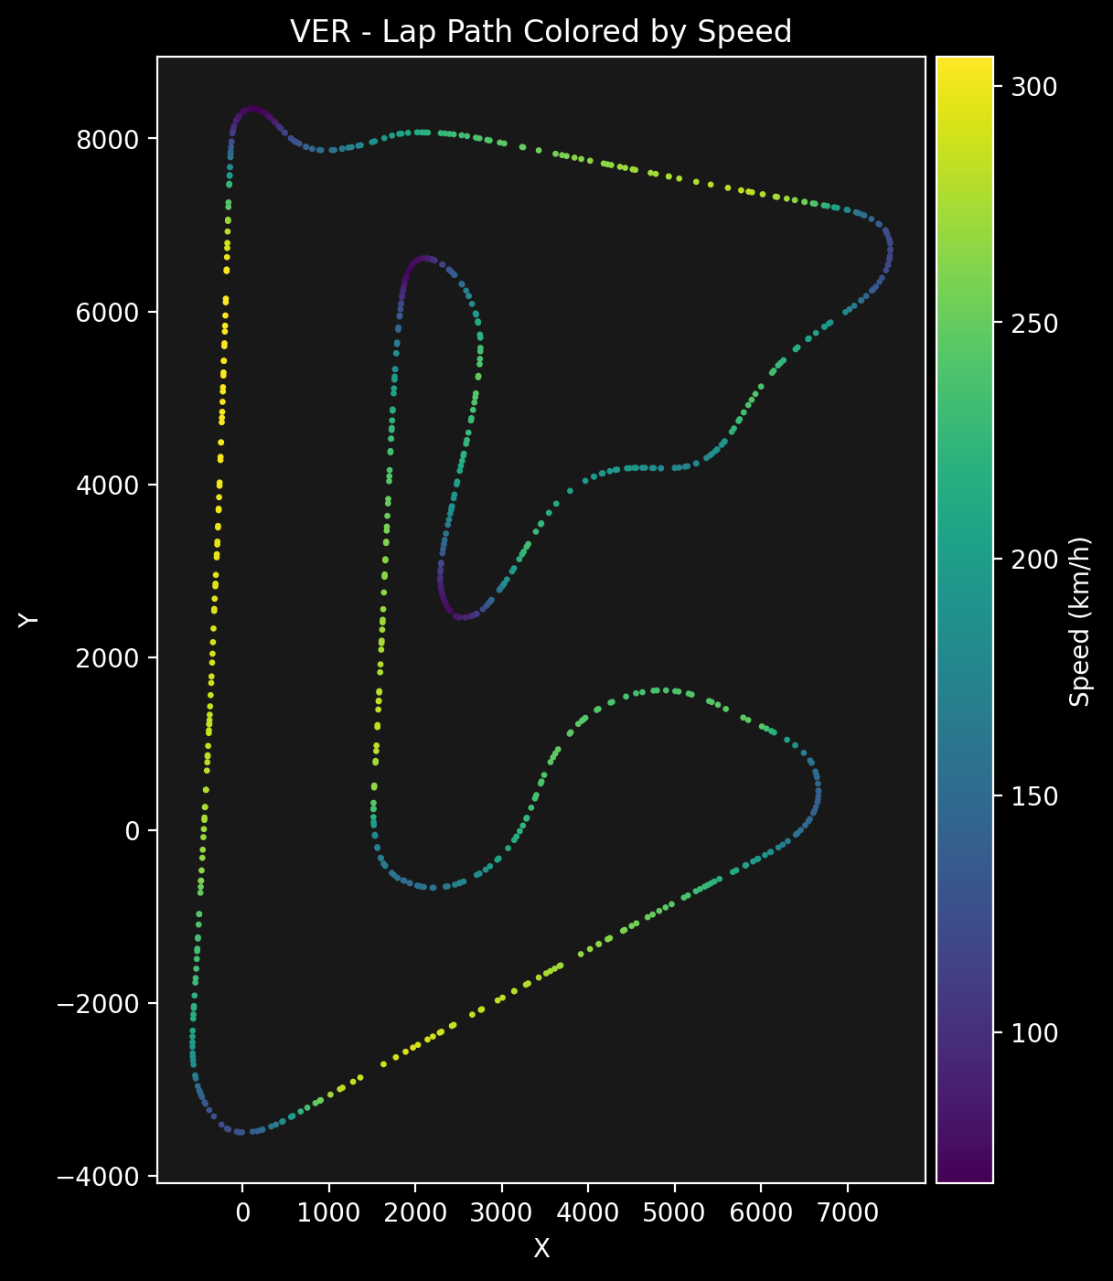
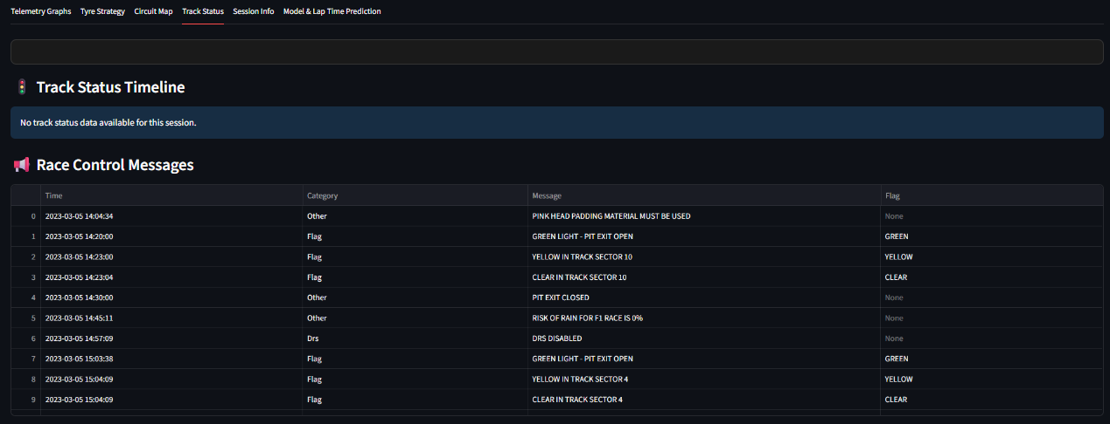
Notes:
Formula 1 overview

Slide 26
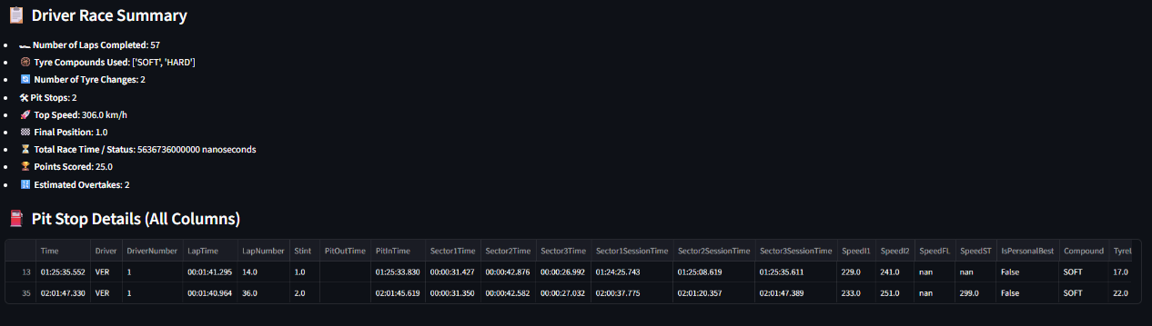
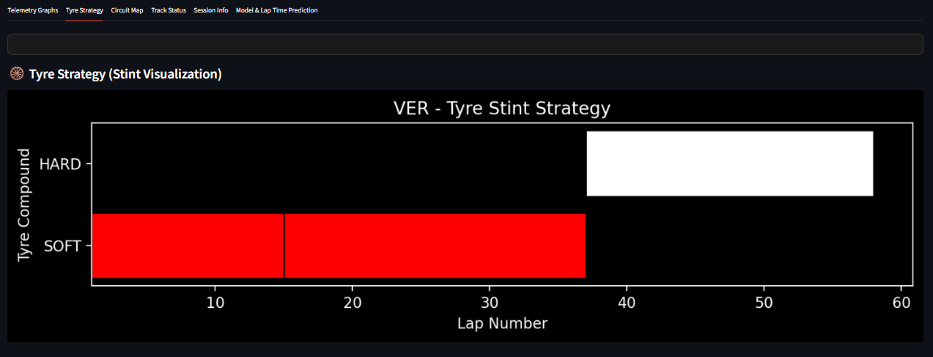
Notes:
Formula 1 overview

